Slide 1
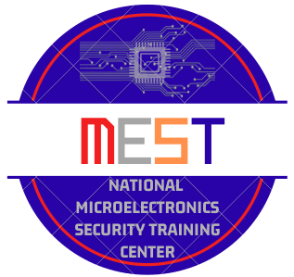




Welcome to the Webinar Offered by: National Microelectronics Security Training (MEST) Center
Sponsors:
Notes:
Welcome to the Microelectronics…webinar titled this this
Until 12:03 or send to instructor to have them keep slide for the first 5-8 minutes MEST Logo title and logo name
Uf logo and OSU logo, sponsors AFRL and Nimbis.

Slide 2

Introduction to System on Chip Development of a Basic System-on-Chip Architecture in FPGA
Abigail Butka, Kawser Ahmed Muhammed, Christophe Bobda
National Micro Electronics Security Training (MEST) Center

Slide 3
Agenda
Introduction and Motivation
System on Chip
Introduction and Motivation
Definition
Examples
Benefits
Challenges
Basic Lab Architecture
Conclusion and Discussion
National Micro Electronics Security Training (MEST) Center

Slide 4
Introduction and Motivation - Moore’s law
The most important trend in computer systems
Predicted in 1965 by Intel co-founder Gordon Moore
IC transistor capacity has doubled roughly every 18 months for the past several decades
Today’s high-end chips may contain Billions transistors
Transistor gate lengths (feature size) are now in term of nanometers
From 180nm in the 2000s to 40nm in 2014 and 3nm today
In 2020, Samsung and TSMC entered volume production of 5 nm chips, manufactured for companies including Apple, Marvell, Huawei and Qualcomm
Approximately every 18 months the number of transistors on a chip doubles – Moore’s law
The Consequences
Components formerly connected on a Printed Circuit Board can now be integrated onto a single chip
Hence the development of System-On-Chip
National Micro Electronics Security Training (MEST) Center

Slide 5
SoC- Definition
System: A collection of all kinds of components and/or subsystems that are appropriately interconnected to perform the specified functions for end users.
System-on-Chip (SoC): Complete system on a single chip?
SoC not only chip, but more on “system”
SoC = Chip + Software + Integration
National Micro Electronics Security Training (MEST) Center

Slide 6
SoC- Definition
The SoC Hardware includes
Embedded processor
Hardware IPs
Peripherals and analog circuitry
Embedded memory
Interconnect
The SoC Software includes:
OS, compiler, simulator, firmware, driver, protocol stack, Integrated development environment (debugger, linker), Application interface (C/C++, assembly)
A key benefit of SoCs is the concept of IP Reuse
IP reuse allows hardware designers to reduce development time by not re-making the wheel
National Micro Electronics Security Training (MEST) Center

Slide 7
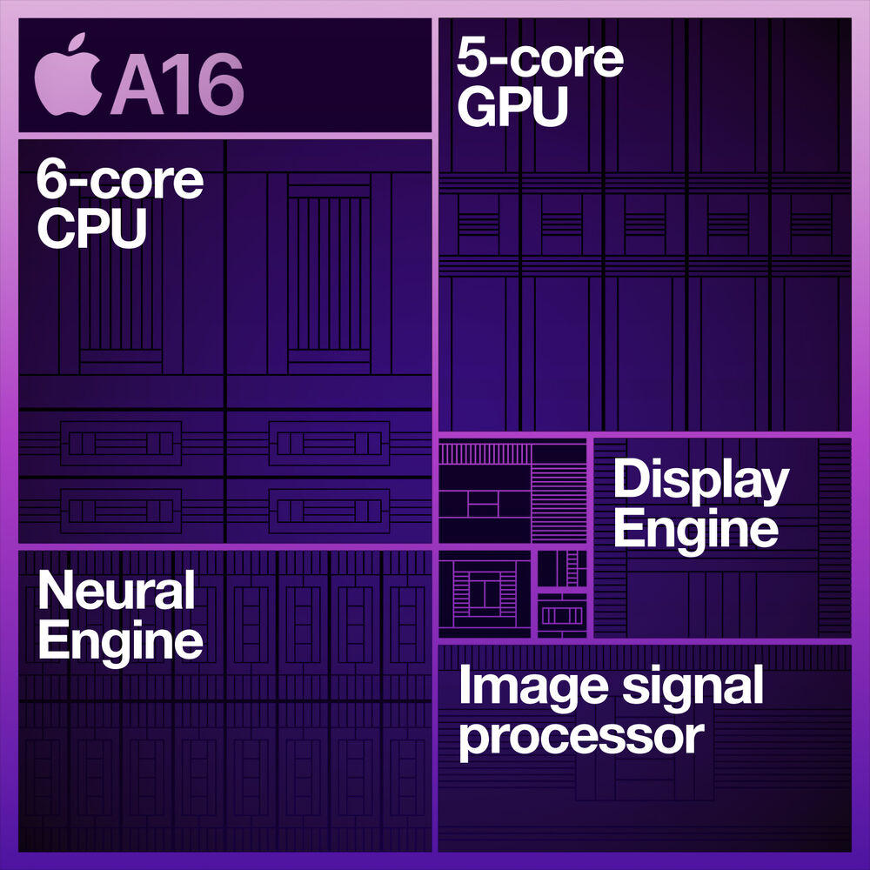
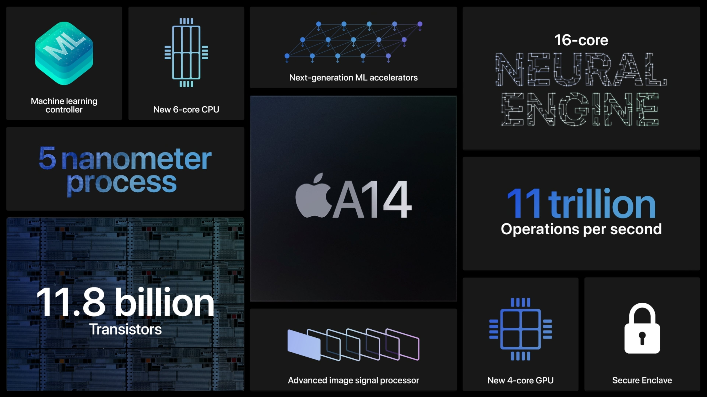
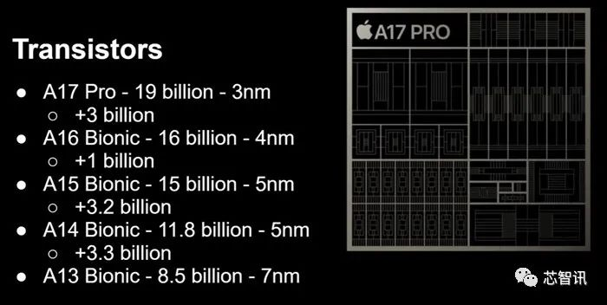
SoC- Examples
Apple A14 Bionic
National Micro Electronics Security Training (MEST) Center

Slide 8
SoC- Benefits
Reduced size
Reduced overall system cost
Lower power consumption
Increased performance
Increased functionality/performance in reduced footprint
Simplified PCB design
Increased product mechanical robustness
And more and more advantages …
National Micro Electronics Security Training (MEST) Center

Slide 9
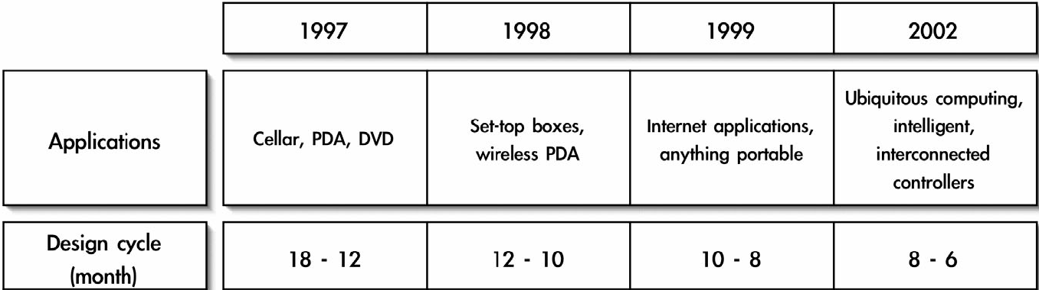
SoC- Challenges
Increasing complexity
Hardware/Software integration!
Time-to-market pressure
Shorter product lifespan
Shorter design cycles
Verification bottleneck
Assume you must 100% verify a two-input 32’bit multiplier. This is 2^64 = 18,446,744,073,709,551,616 test cases!!
If it takes 1ns to perform one test, fully testing this simple multiplier would take over 500,000 years
National Micro Electronics Security Training (MEST) Center

Slide 10
SoC- Application Challenges
Speech Signal Processing
Image and Video Signal Processing
Information Technologies
PC interface (USB, PCI,PCI-Express, IDE,..etc) Computer peripheries (printer control, LCD monitor controller, DVD controller,.etc) .
Data Communication
Wireline Communication: xDSL, Gigabit Ethernet, Etc…
Wireless communication: BlueTooth, WLAN, 2G/3G/4G, WiMax, UWB, etc…
Consumer
Game box
Digital Camera
Automotive
National Micro Electronics Security Training (MEST) Center

Slide 11
Case Study and Tutorial

